Slide 1
THE A-MAZE-ING GAME

Slide 2
Features
A 90’s inspired maze game.
Different levels, with different sizes mazes
A sophisticated way of calculating individual score
Maintains a list of high scores
An appealing user-interface
An era-accurate background music

Slide 3
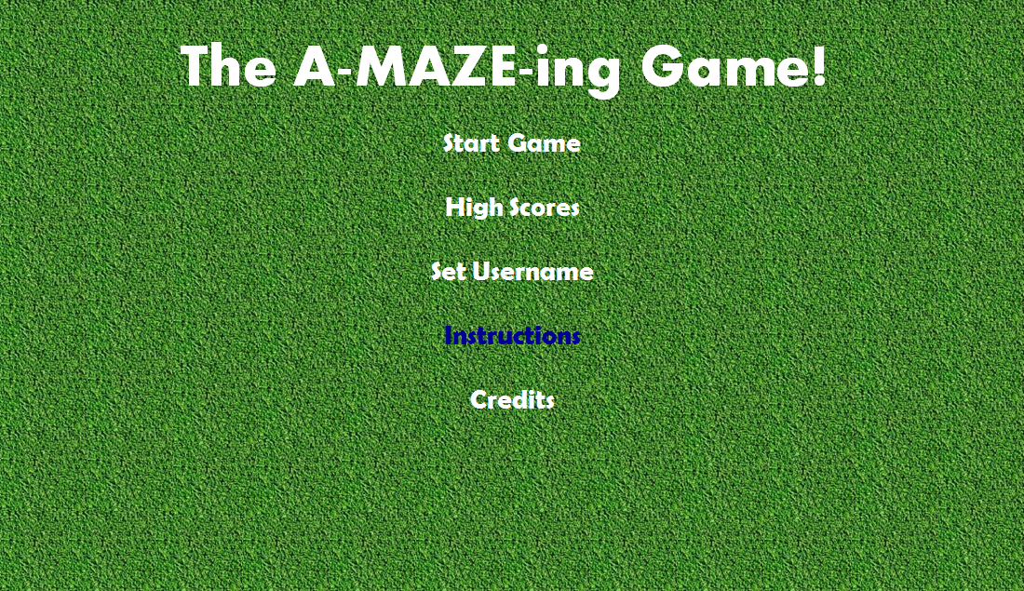
How to Play:

Slide 4
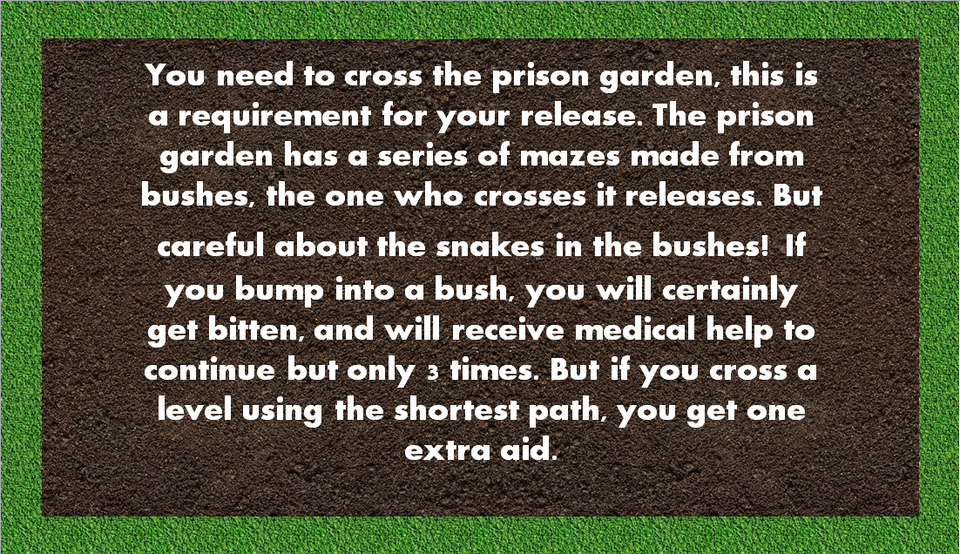
How to Play:

Slide 5
Coding:
The game is made using PyGame library.
The mazes are generated using maze matrix.
The maze has two ways, the shortest one being calculated using dijkstra’s algorithm.
The high score calculated using time function
The high score list is sorted using insertion sort

Slide 6
A demonstration:

Slide 7
We Hope You Like it!

